Slide 1




Behavioral Health Barometer
Wood County Youth
Indicators as measured through the 2020 ADAMHS
Youth Survey on Addiction and Mental Health
2020
William J. Ivoska, Ph.D.

Slide 2


ATOD Summary
Increases
  Adolescent Vaping
  Marijuana Vaping
  Nicotine Vaping
  Marijuana Use
  Alcohol Use
  Caffeinated Energy Drinks
Decreases
  Heroin
  Narcotic painkillers
No Change
  All illicit drugs

Slide 3
Behavioral Health Summary
Increasing
  Overall Mental Health Problems
  Bullying among 5th and 6th graders
  Suicide Ideation
  ACEs
Decreasing
  Suicide attempts
  Gambling
New Findings
  Gaming

Slide 4

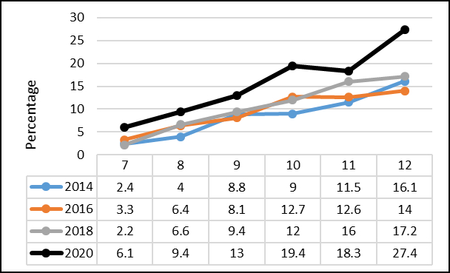
Vaping Past 30-Days
Chart goes here

Slide 5
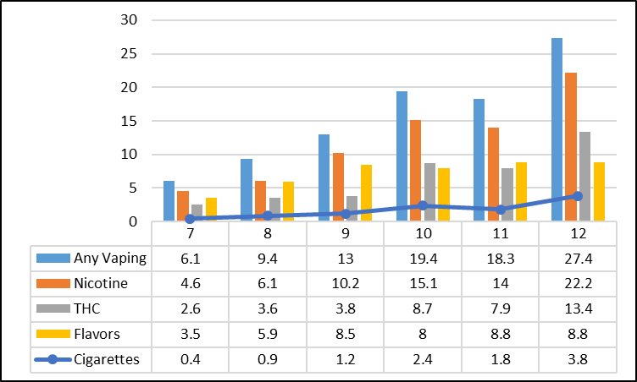
Vaping Past 30-Days – Vape Device Content
Chart goes here

Slide 6
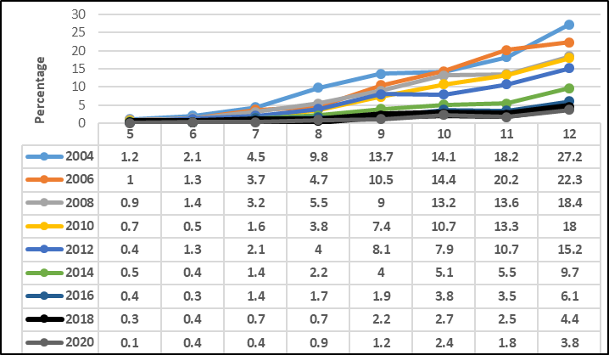

Cigarette Use - Past 30-Days
Chart goes here

Slide 7
Vaping Past 30-Days – Vape Device Content
Chart goes here

Slide 8
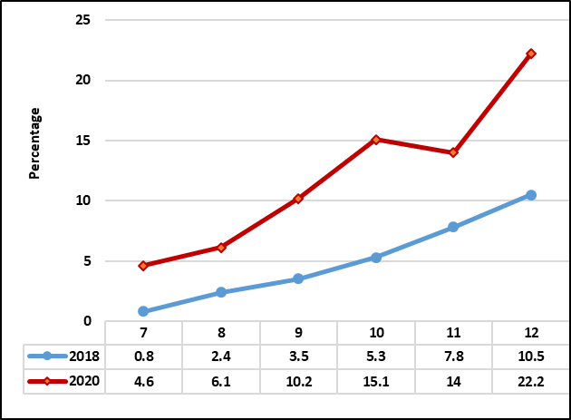
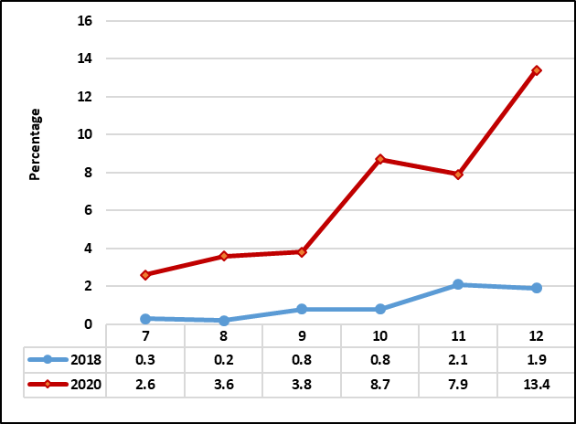
Vaping: Nicotine & Marijuana
Nicotine
Marijuana

Slide 9
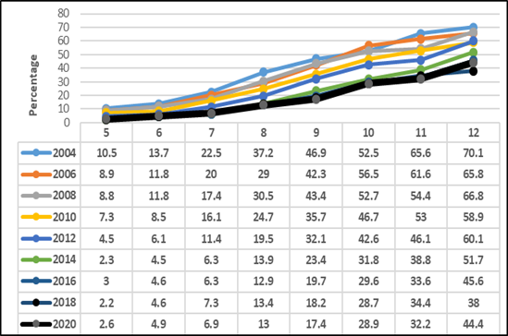
Alcohol Last Year
Chart goes here

Slide 10
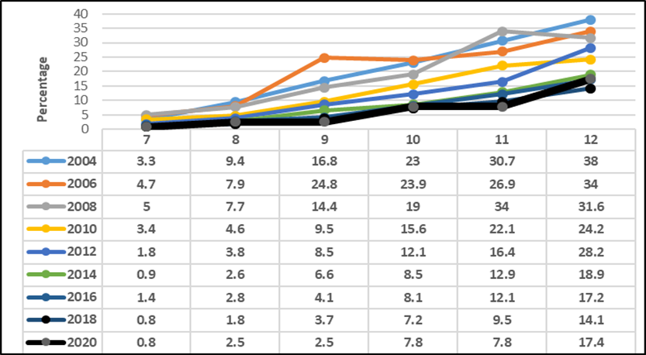

Binge Drinking Last Month
Chart goes here

Slide 11
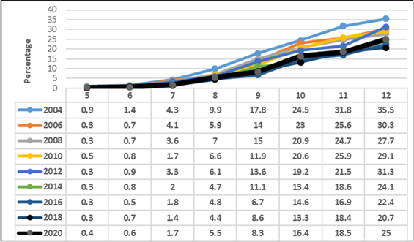
Marijuana Use Last Year
Chart goes here

Slide 12
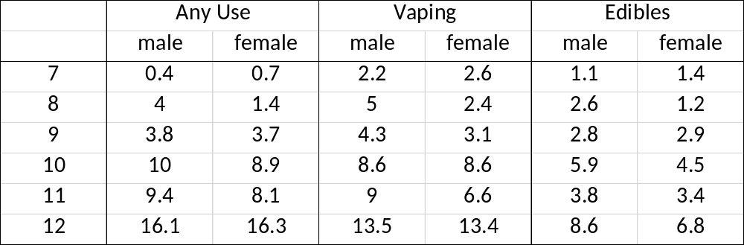
30-Day Marijuana Use by Technique & Gender

Slide 13
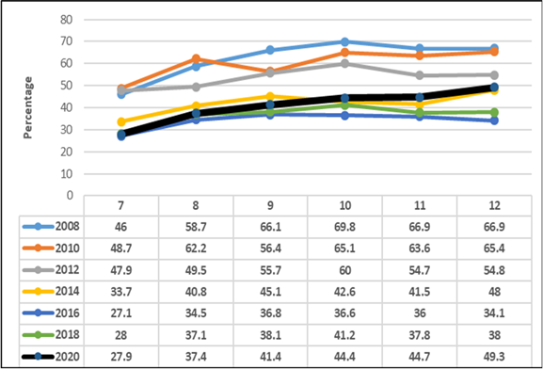
Caffeinated Energy Drinks

Slide 14

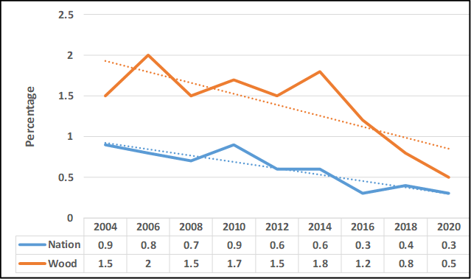
Heroin

Slide 15
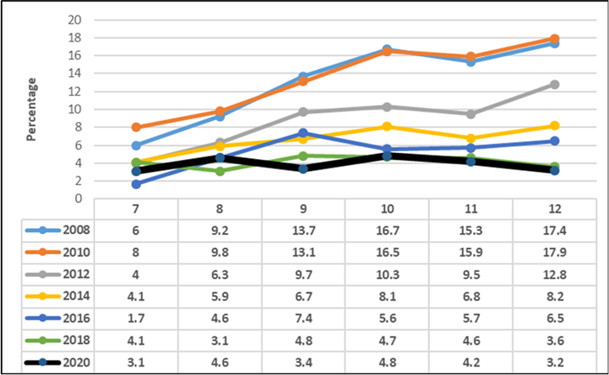
Painkillers

Slide 16

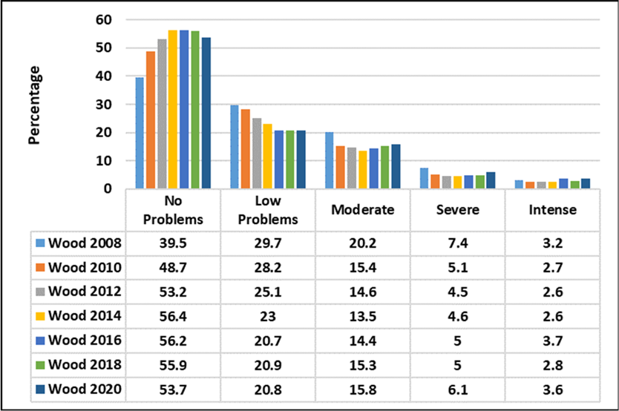
Youth Mental Health
Severe & Intense:
2018 = 7.8%
2020 = 9.7%

Slide 17

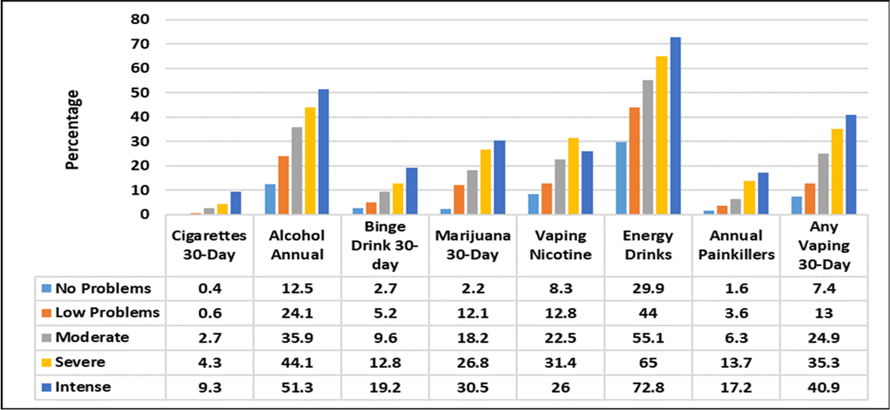
Mental Health and Substance Abuse
Chart goes here

Slide 18
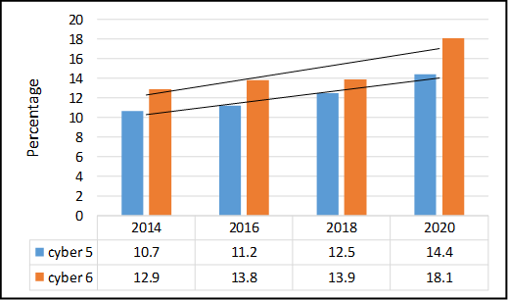
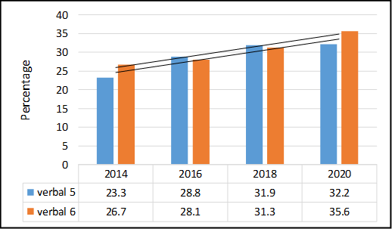
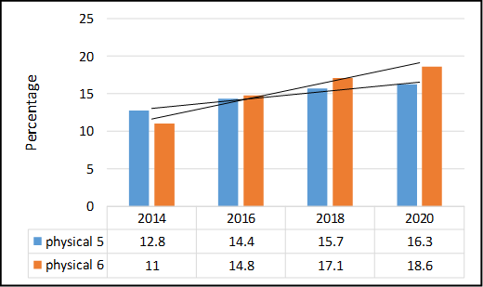
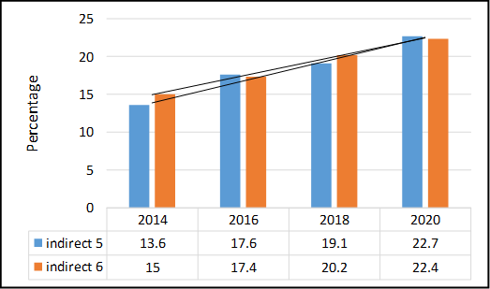
Bullying: 5th and 6th Graders

Slide 19
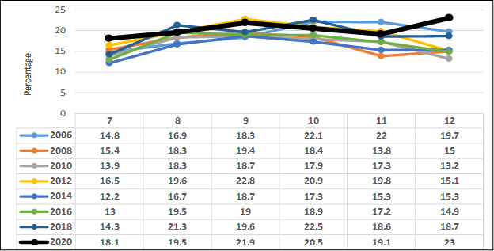
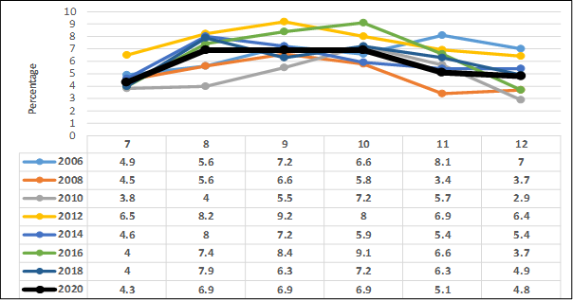
Suicide: Ideation and Attempts

Slide 20
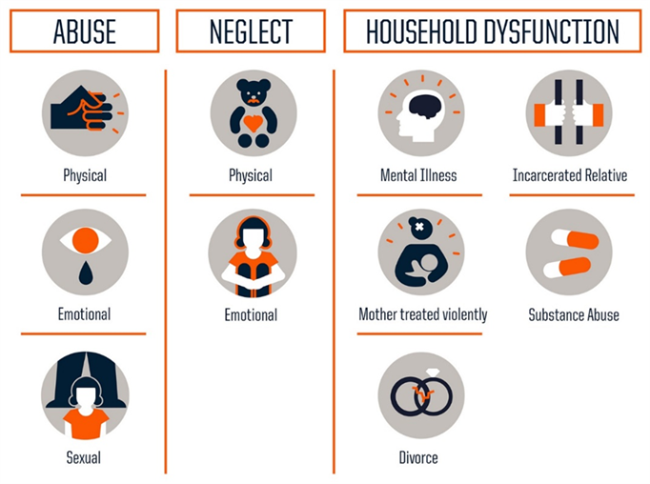
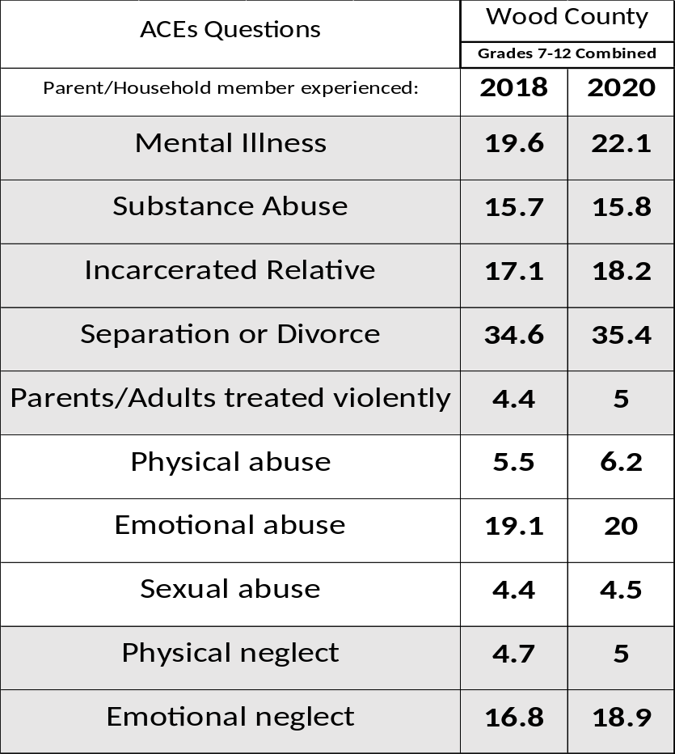
ACEs

Slide 21
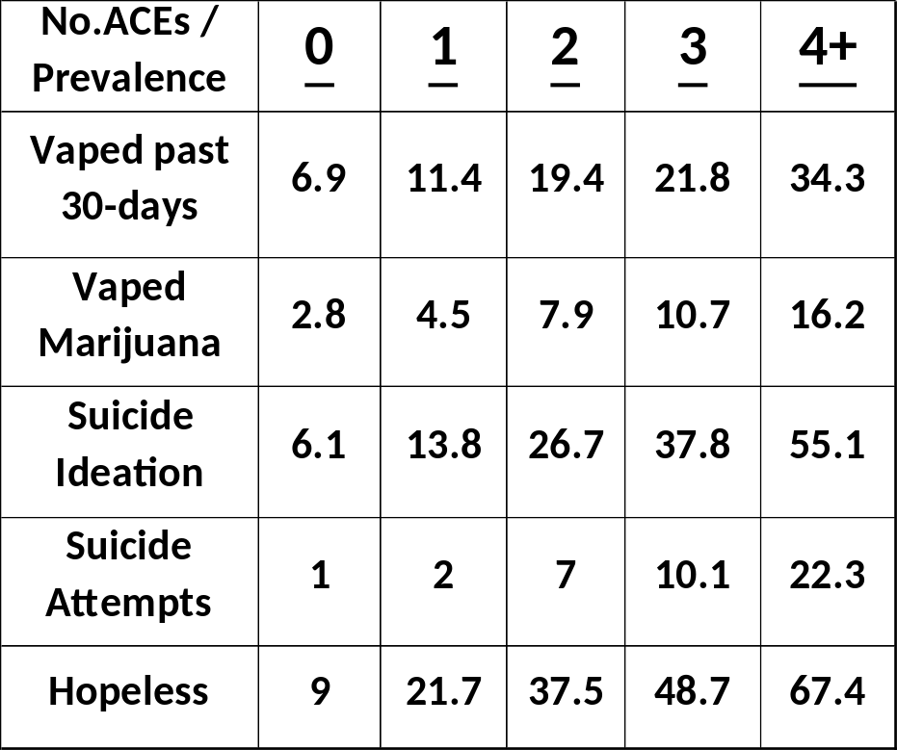
ACEs
As the number of ACEs increase, so does the percentage of at-risk behaviors.

Slide 22

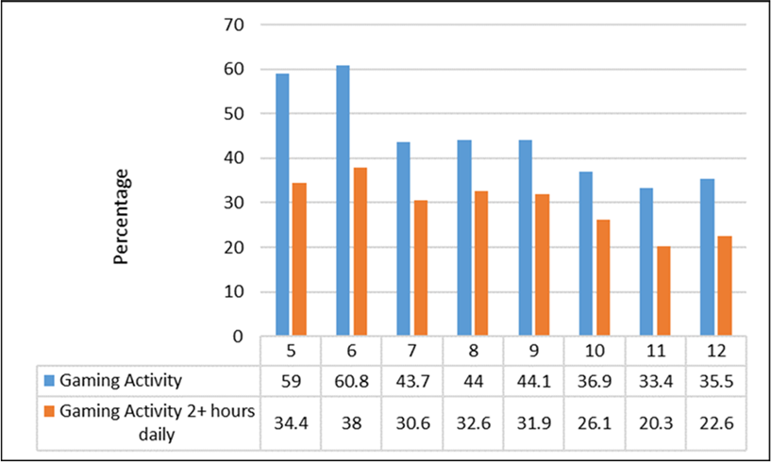
Adolescent ‘Gaming’
Gaming activity is any gaming-related activity that has been played either from a computer/lap-top or from a gaming console or any other kind of device (phone, tablet) on or offline

Slide 23
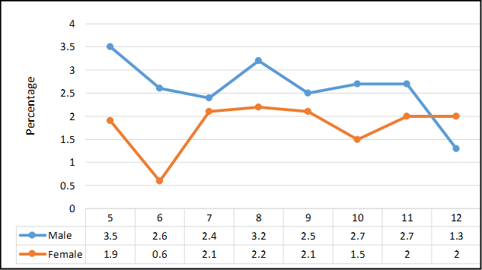
Adolescent ‘Gaming’
Teens took an Internet Disorder Gaming Scale (Pontes, 2015) – 5th and 6th grade males reported the highest levels of problem gaming

Slide 24
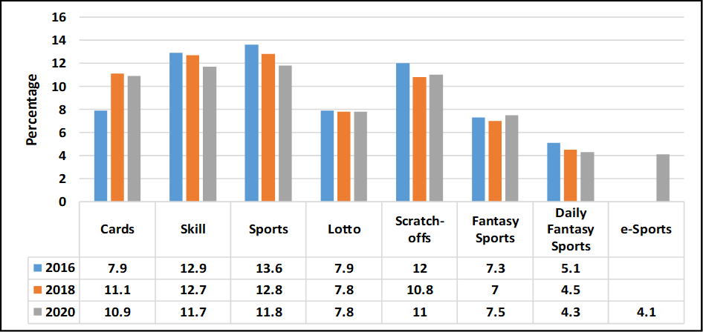
Adolescent ‘Gambling’

Slide 25
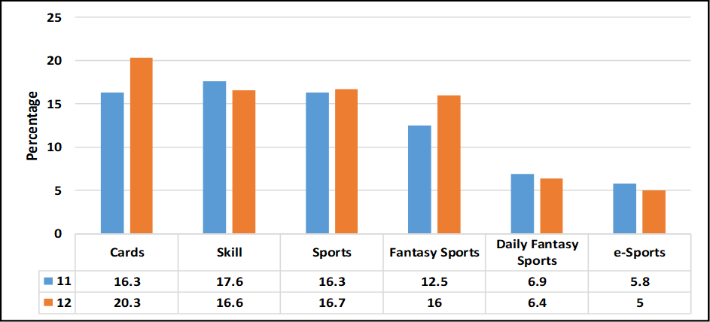
Adolescent ‘Gambling’ – 11th & 12th grade males

Slide 26



ATOD Prevalence 2018-2020
Grades 7-12 combined
40% | Caffeinated Energy Drinks
21.9% | Alcohol
14.7% | Vaping (30-day)
10.7% | Marijuana
7.1% | Cough Medicine
6% | Painkillers
4.5% | Benzos
2.3% | Methylphenidate
2.2% | Inhalants
1.5% | Cigarettes
1.3% | LSD
<1% | All Other Drugs

Slide 27
Vaping Past 30-Days – Vape Device Content
Chart goes here
No Nic
Yes Nic

Slide 28
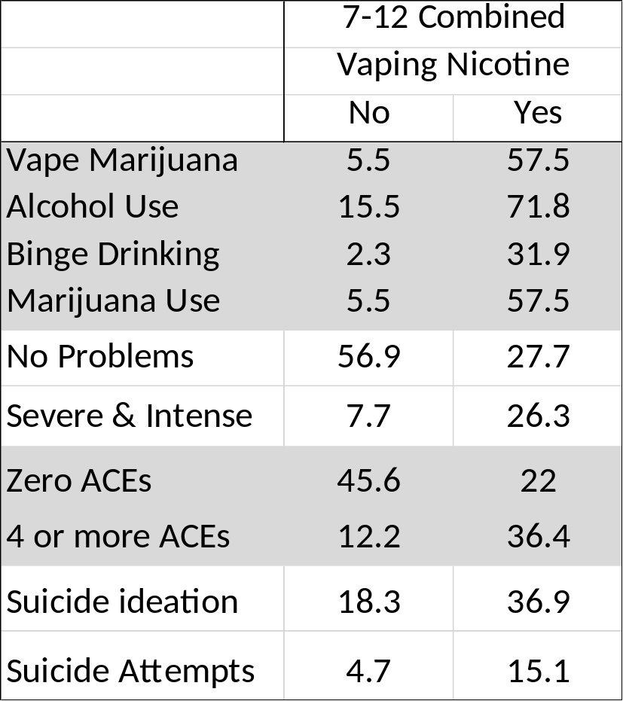
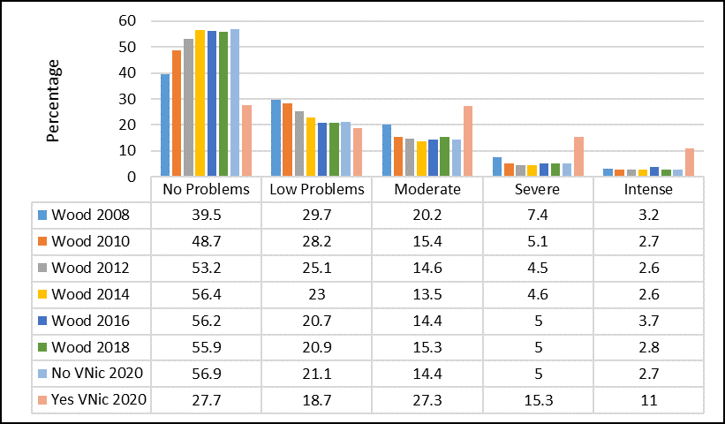
Vaping Nicotine Past 30-Days

Slide 29
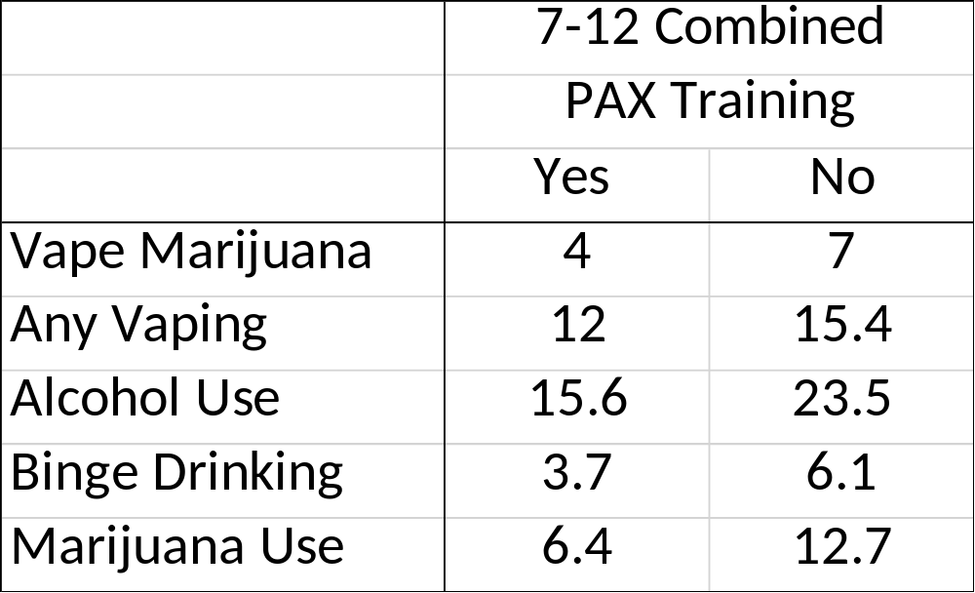
PAX Training

